Slide 1
Create sequence
Milind Parab

Slide 2
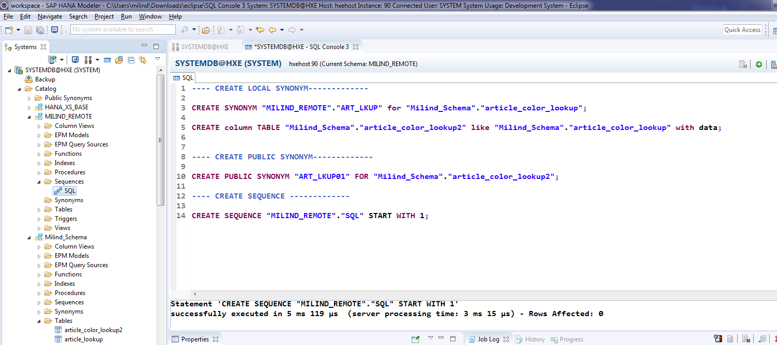
Create Sequence.

Slide 3
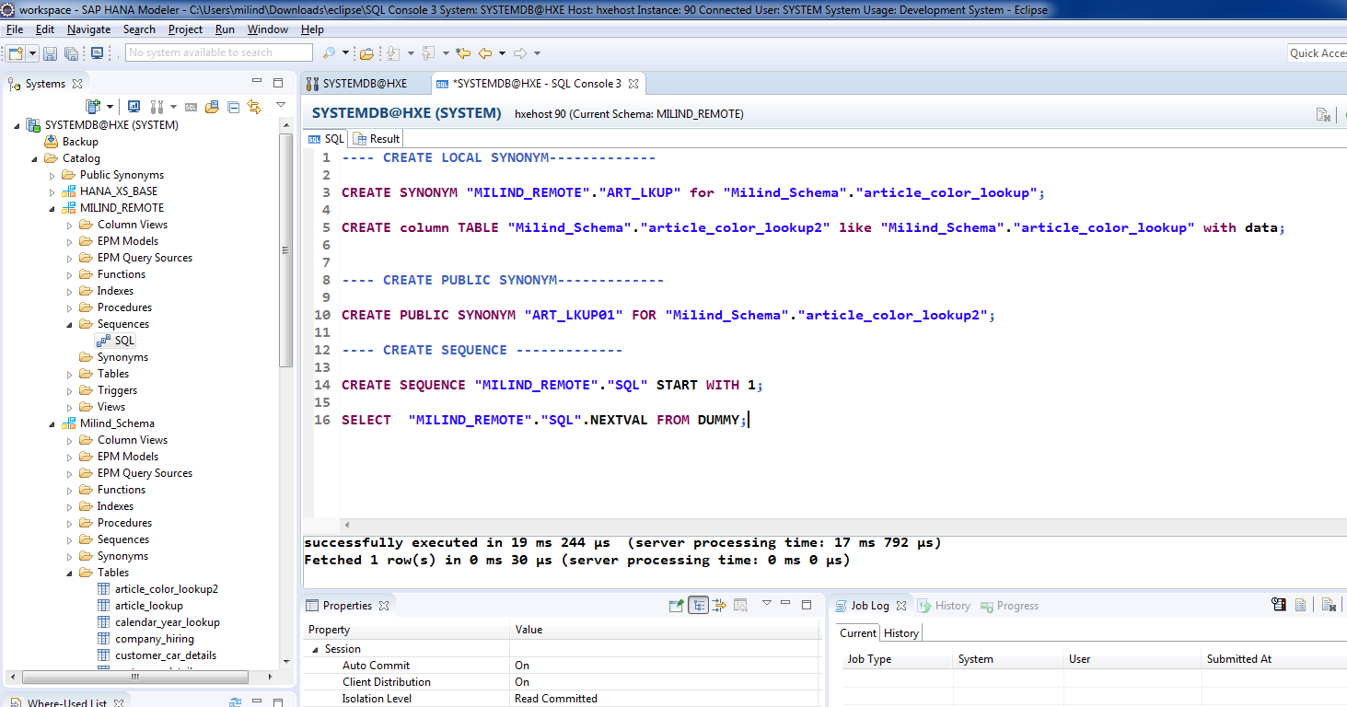
Cont.

Slide 4
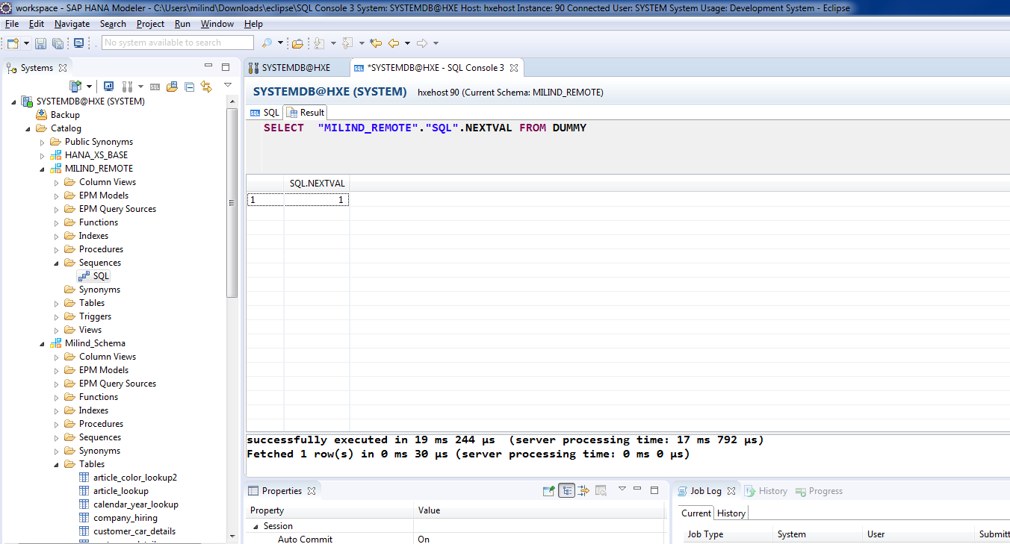
Cont.

Slide 5
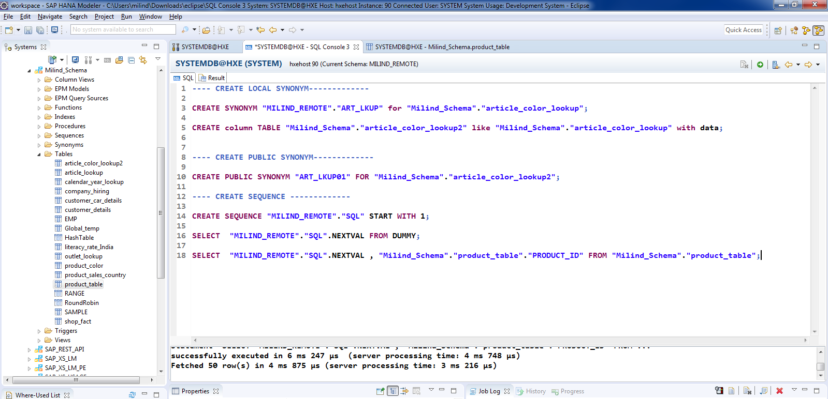
Create Sequence No.

Slide 6
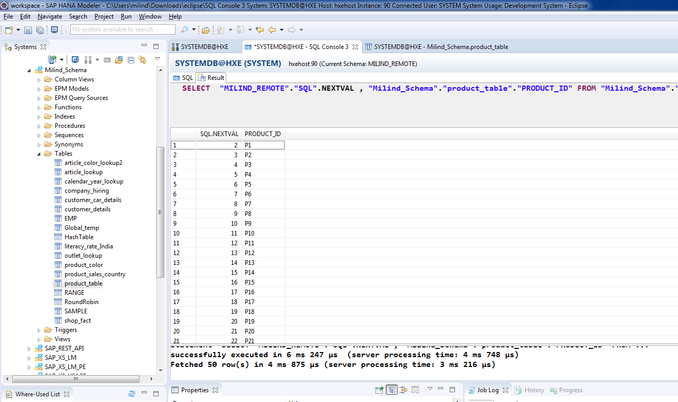
Sequence No.

